Slide 1
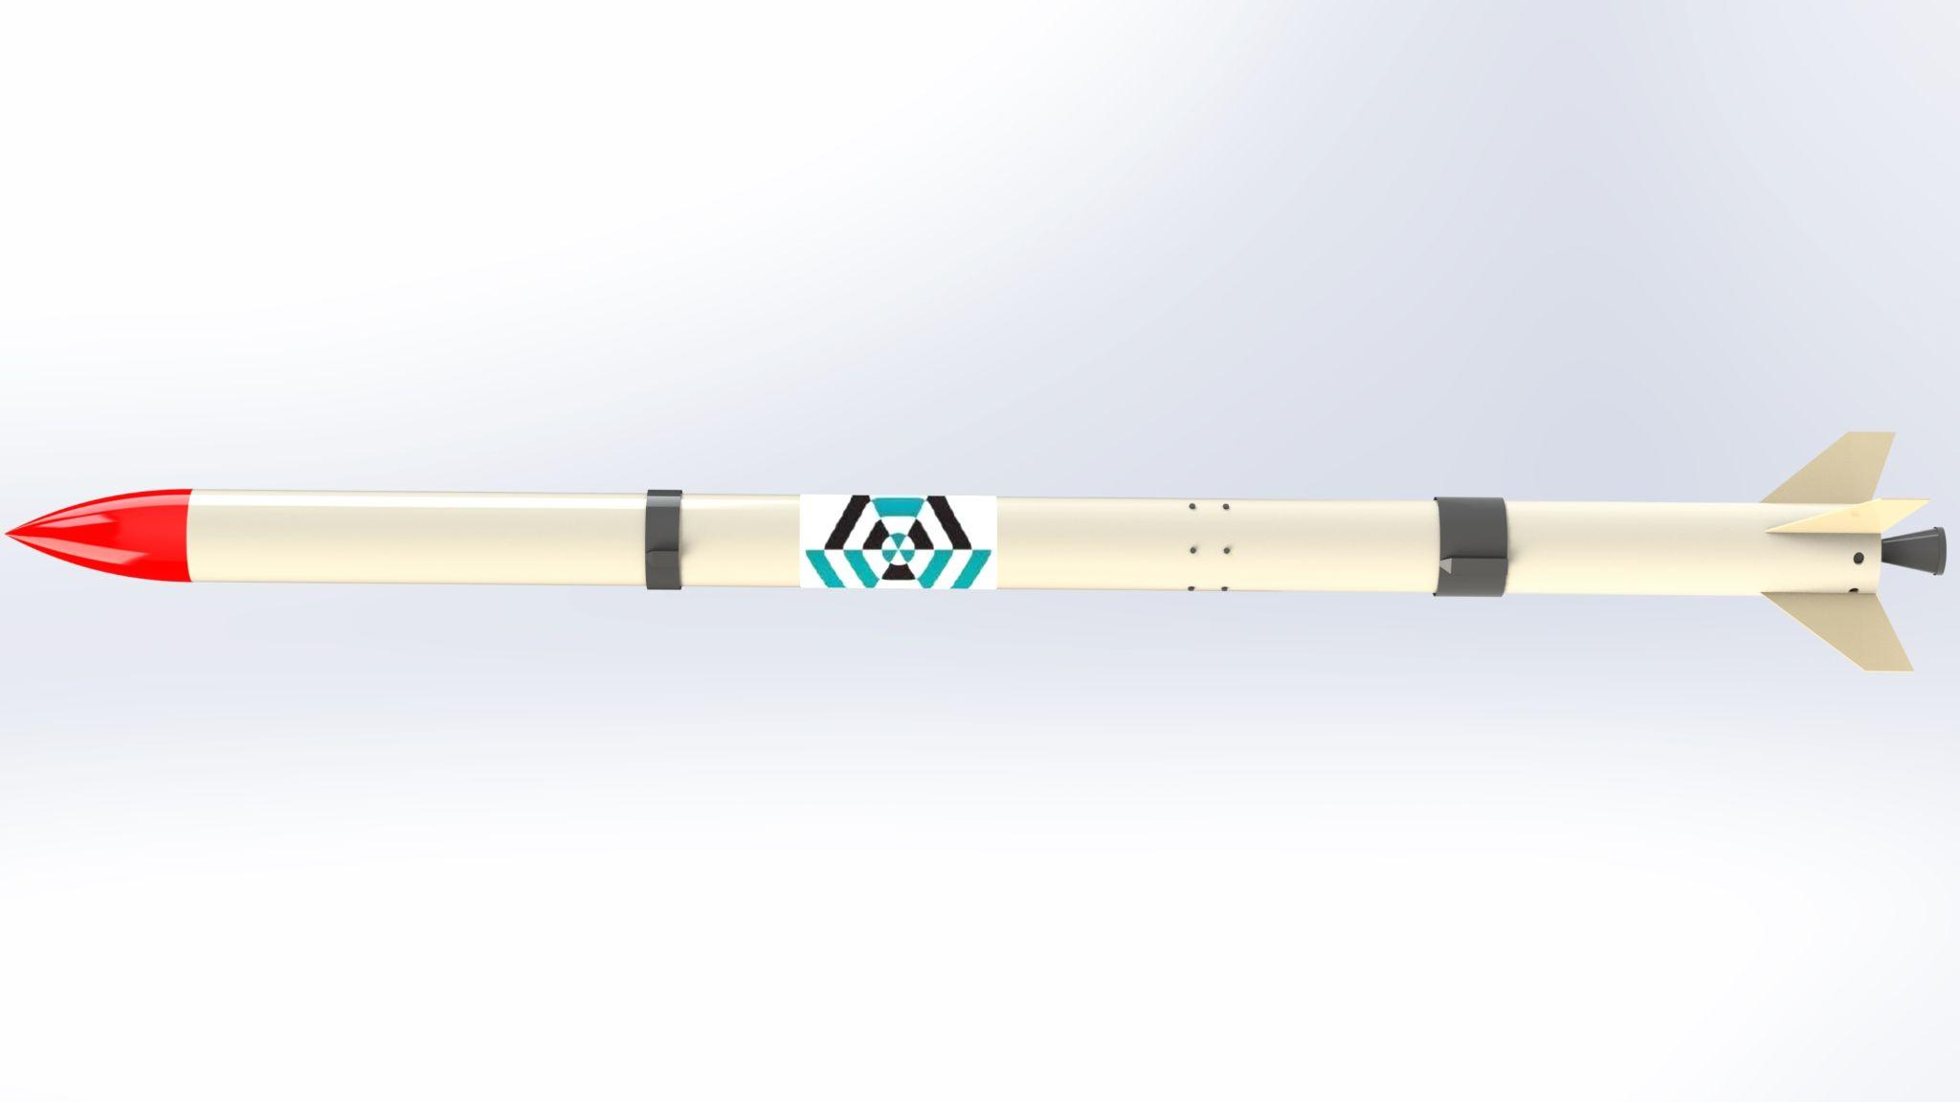
Airframe Progress Report
-26/4/2023-
no_reply@example.com

Slide 2
OVERVIEW
Design and analysis of the Launch pad
Sanding and finalizing the fin fiberglass.
Yet to be accomplished:
Fabrication of the fin alignment jig

Slide 3
Launchpad
#20
We designed the launchpad and did the strength and stress analysis to check it’s feasibility.
We will be using mild steel for the same.

Slide 4
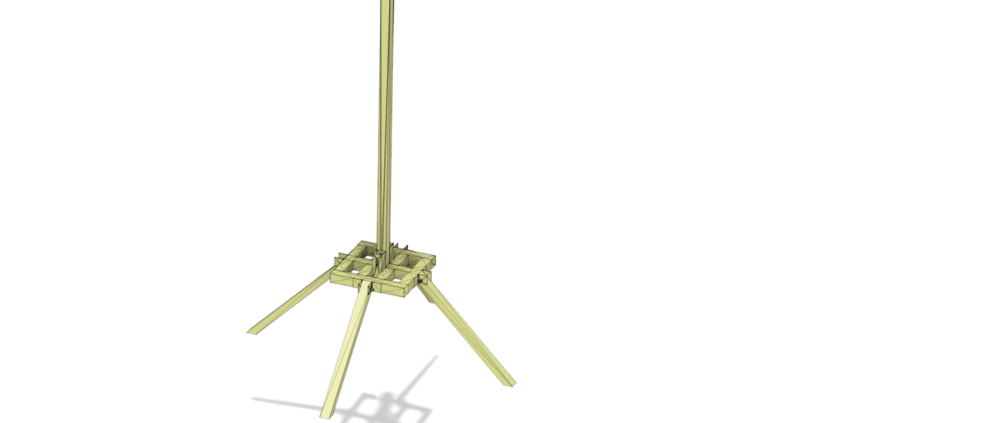
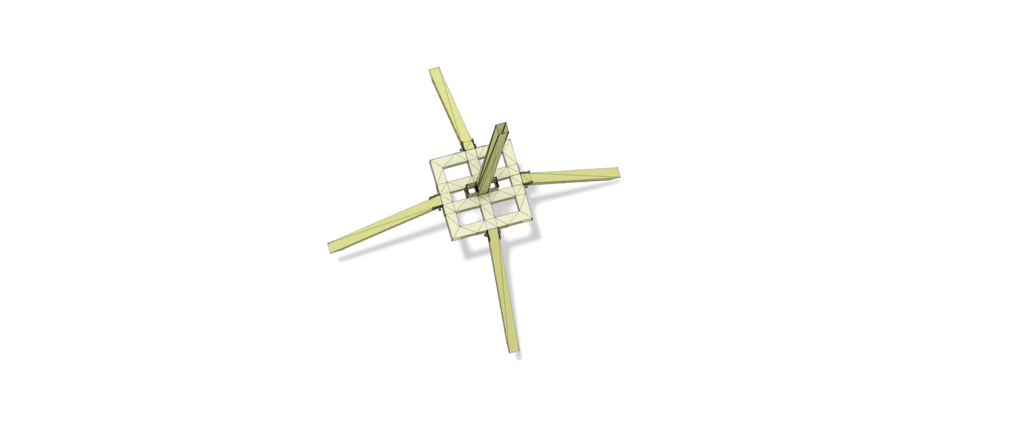

Slide 5
Launchpad
#20
For the designed launchpad, we have an approximate surface area of 560cm2 and a volume of 1100cm3.
This roughly translates to a 9kg mass with the density of mild steel being 7.8g/cm3.

Slide 6
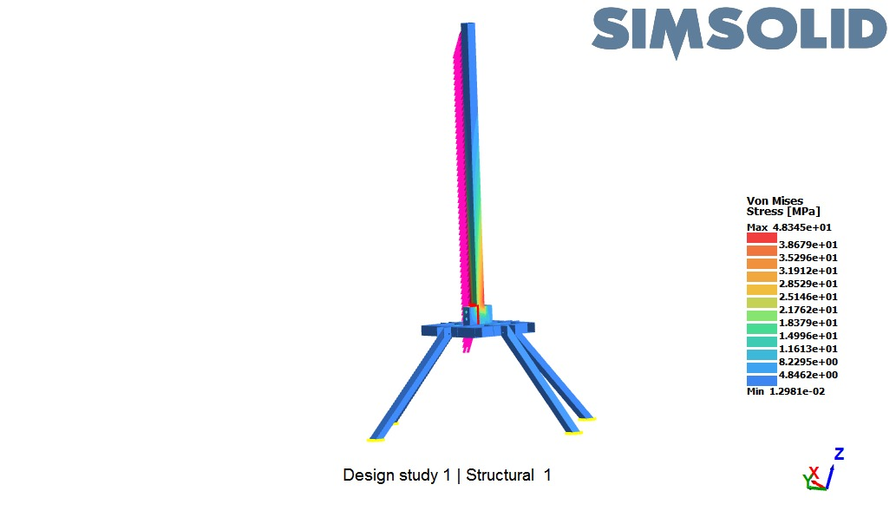
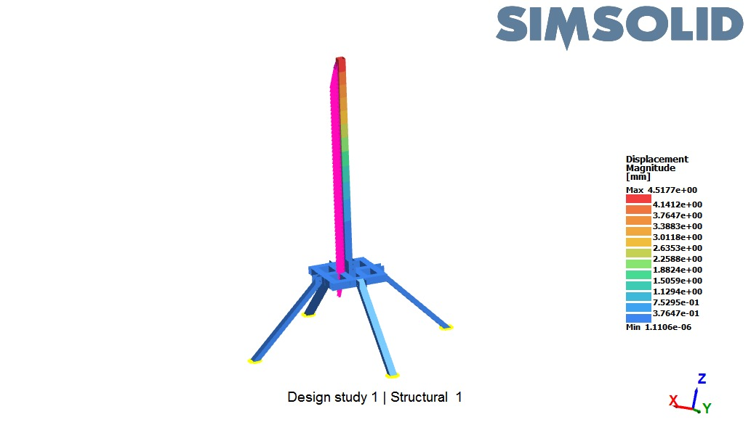
Asymmetric 500N force was applied to the launchpad and from the simulations most of the
distortion was exerted on the top of the rail.
From this we simulated a 4.5mm displacement of the rail during launch incase of any forces that would otherwise not be acting to the direction of the trajectory.
And a 4.8MPa stress was exerted on the rail. (Mild steel stress = 200MPa at 4 degree safety factor)

Slide 7
Fiberglass plate for the fins
Sanded the fin fiberglass.
Yet to apply gloss and cut into required fin size.
Thickness = 2mm

Slide 8
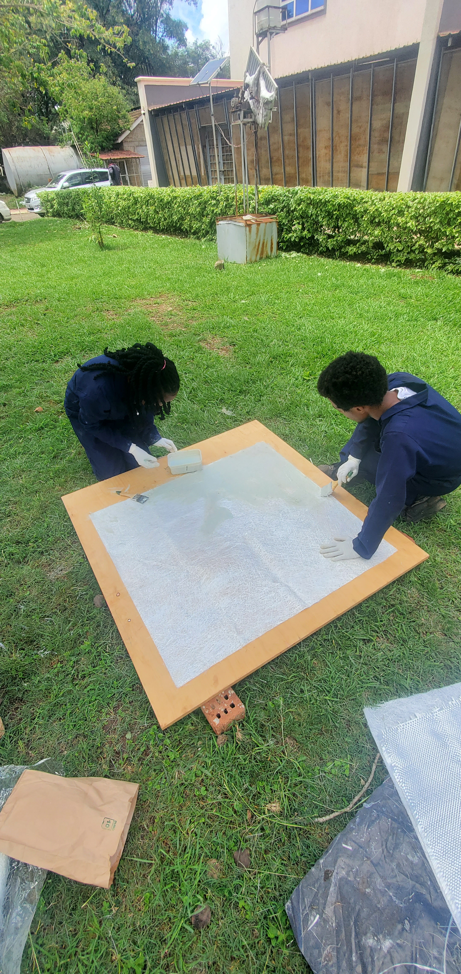

Slide 9
NEXT WEEK’S OBJECTIVES
Fabrication of Launch pad
Assembly of the fiberglass tubes.

Slide 10
THANKYOU
Q/A

